Slide 1



THE PET CLUB
TEAM CREATORS
S.No | NAME | ROLL NO | ROLE
1 | AJENDRA . A . S | AIDS013 | DESIGNER & DEVELOPER
2 | DHARSHINI PRIYA . R | AIDS044 | DESIGNER
3 | DEEPAN . R | AIDS037 | DEVELOPER
4 | AADHITYA BALU . S | AIDS001 | DEVELOPER
DATE : 27/12/2024

Slide 2
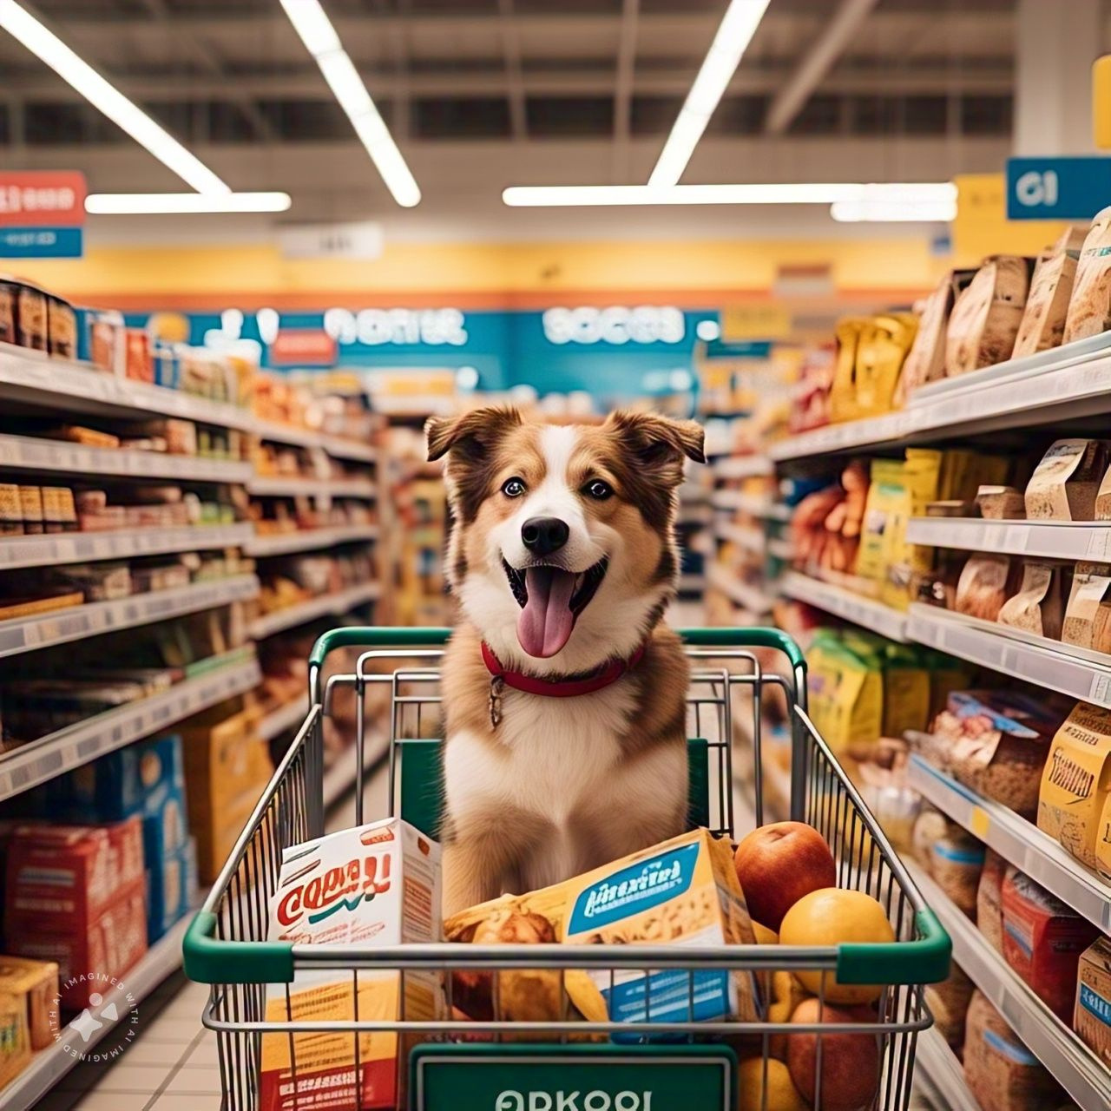

Problem Statement :PS002
🐶 Millions of pets are abandoned or lost each year,
leading to overcrowded shelters and high euthanasia rates due to limited resources.
🐶 Despite the demand for pet companionship, many
potential adopters face barriers such as lack of awareness or misinformation about
rescue animals.
🐶This issue highlights the urgent need for streamlined adoption processes,
public education, and innovative solutions to connect pets with loving homes.

Slide 3
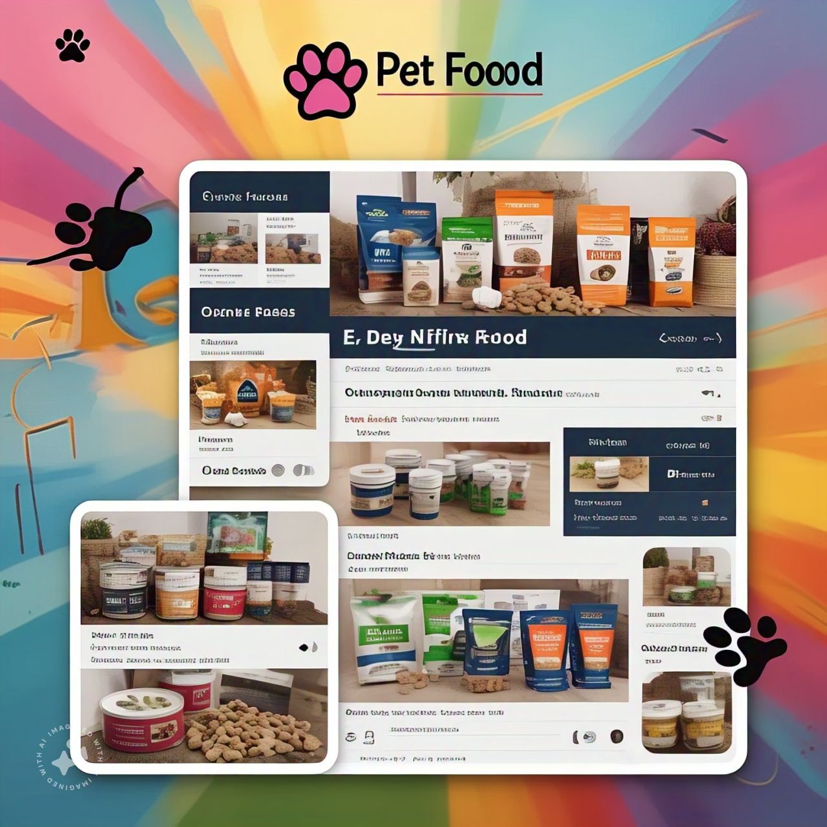
Solution Overview:
🐶 This pet rehabilitation and adoption website focuses on rescuing,
rehabilitating, andrehoming animals in need.
🐶 It highlights pets recovering from injuries, neglect, or trauma,
providing detail about their care journey and current health.
🐶The platform connects these rehabilitated animals with
compassionate adopters while offering resources on pet care and
rehabilitation.
🐶This approach ensures a second chance at life for rescued
animals and promotes responsible, informed adoptions.

Slide 4
Features & Functionality :
User intraction:
🐶Users can navigate through different sections like services, features, and FAQs.
Ability to click "View Details" for more information about the respective services.
Service Offerings:
🐶Users can learn about and potentially participate in dog adoption. Information on
rescue operations and medical care for pets. Purchase pet food and other essentials.
E-commerce Integration:
🐶Likely includes shopping cart functionalities(not visible but implied by the
ecommerce nature).
🐶The ability to book services, adopt pets, or make donations

Slide 5

Technical Details:
Your paragraph textHeader and Navigation Menu:
Logo and Branding: The "The Pet Club" logo and name are prominently displayed.
Menu Options: Includes links to Home, Features, Login, FAQs, and About sections for easy navigation.
Services Section:
Dog Adoption: Provides details about adopting pets, specifically dogs.
Rescues and Cares: Highlights services like donations, sponsorships, and medical care.
Nourish Your Furry Friend: Offers pet food and nutritional
products.
Call-to-Actions:
"View Details" Buttons: Allows users to explore more
details about specific services or offerings.

Slide 6
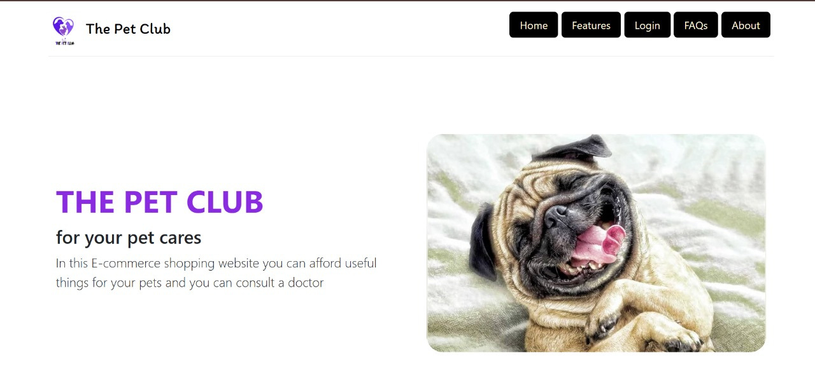
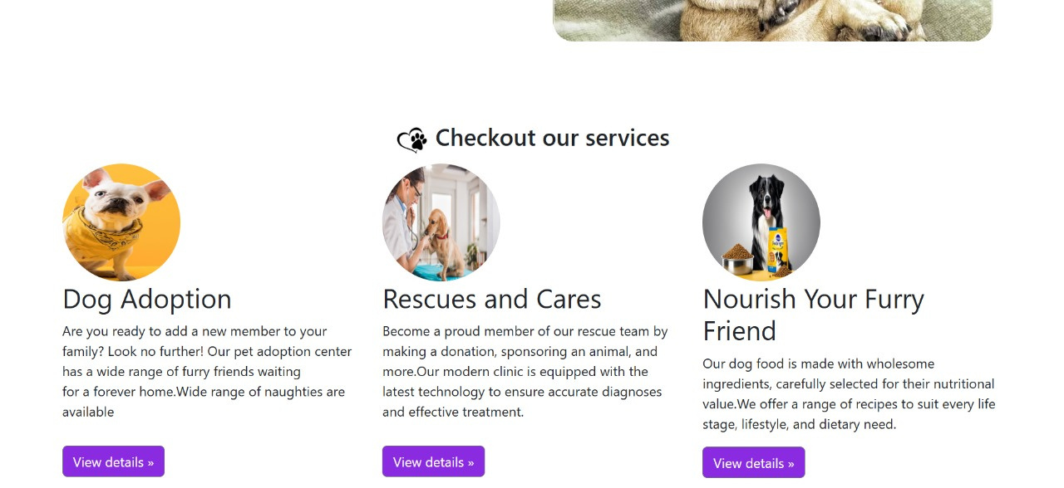
User Interface:

Slide 7
Implementation :
HTML:
Structure the web pages, including the header, navigation menu, hero section, and services section.
Use semantic tags like <header>, <nav>, <section>, <article>, and <footer> for better readability and SEO.
CSS:
Design the layout, colors, fonts, and overall visual aesthetics.
Use modern CSS techniques like Flexbox or Grid for responsive design.
Implement hover effects on buttons like "View Details" to improve user experience.
JavaScript:
Add interactivity, such as dropdown menus, smooth scrolling, and dynamic content
loading.
Enable features like modals or pop-ups for additional information when
"View Details" is clicked.

Slide 8
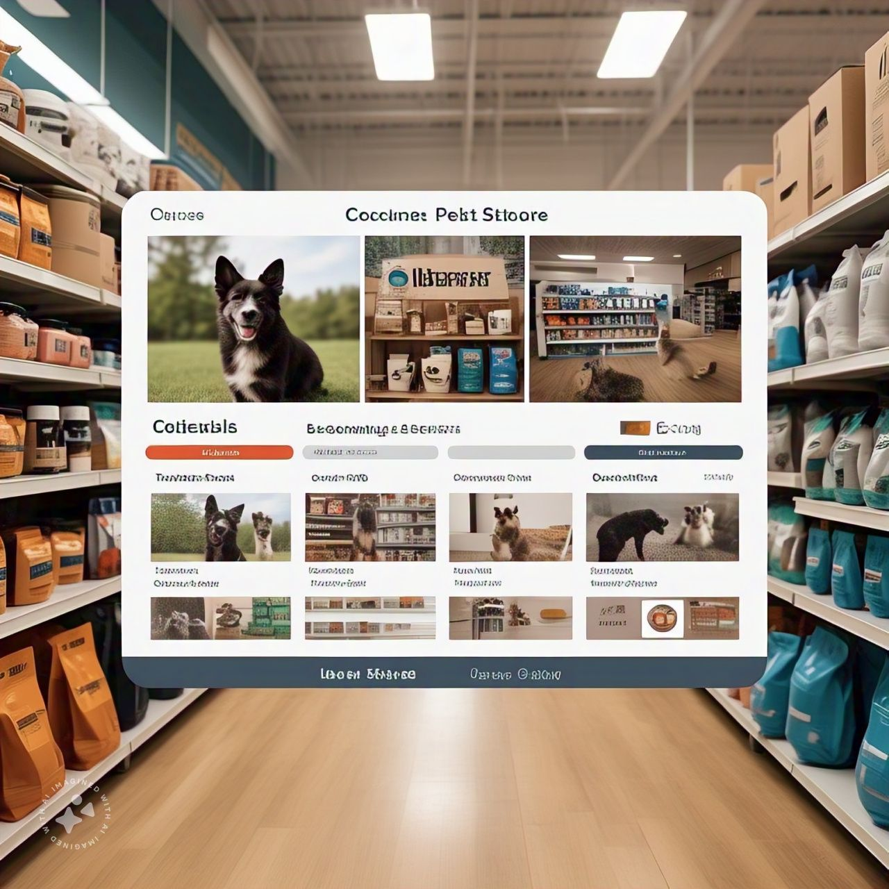
Results & Impact:
Increased Adoption Rates:
🐶 Connecting Pets with Home.
🐶 Wider Reach.
Reduced Euthanasia Rates:
🐶Saving Lives.
🐶Promoting Fostering Programs.
Enhanced Animal Welfare:
🐶Rehabilitation and Care.
🐶Education for Adopters.
git hub: https://github.com/Axdhi05/Pet-Club

Slide 9
Future Work:
Interactive Pet Profiles:
360° Pet View:
🐶Add a feature that allows users to see a 360° view of each pet to get a better sense of their appearance and demeanor.
Video Introductions: Include short videos of pets interacting with staff or playing to showcase their personality.
🐶Behavioral Tags: Use tags like "good with kids," "calm," "energetic," or "trained" to help users filter and find their ideal
pet match.
Mobile App Development:
🐶Create a dedicated app for your platform, offering users push notifications about newly available pets or updates on
their applications.
🐶Incorporate features like reminders for vaccination and vet appointments for adopters.
Educational Resources :
🐶Create a blog or knowledge hub with content on pet care, training tips, and rehabilitation success stories.
Offer downloadable guides and checklists for new adopters.
🐶Host webinars or Q&A sessions with veterinarians, trainers, and behaviorists.

Slide 10
Q&A

Slide 11
THANK YOU

